Slide 1

All NBA Teams Project
What does make a player be elected in the All NBA Teams?
Pablo Iglesias Quián
Ironhack Data Analytics Bootcamp
16/02/2024
Data from players that started 35 games or more
Seasons from 1989-90 to 2022-23
This Photo by Unknown Author is licensed under CC BY-SA

Slide 2
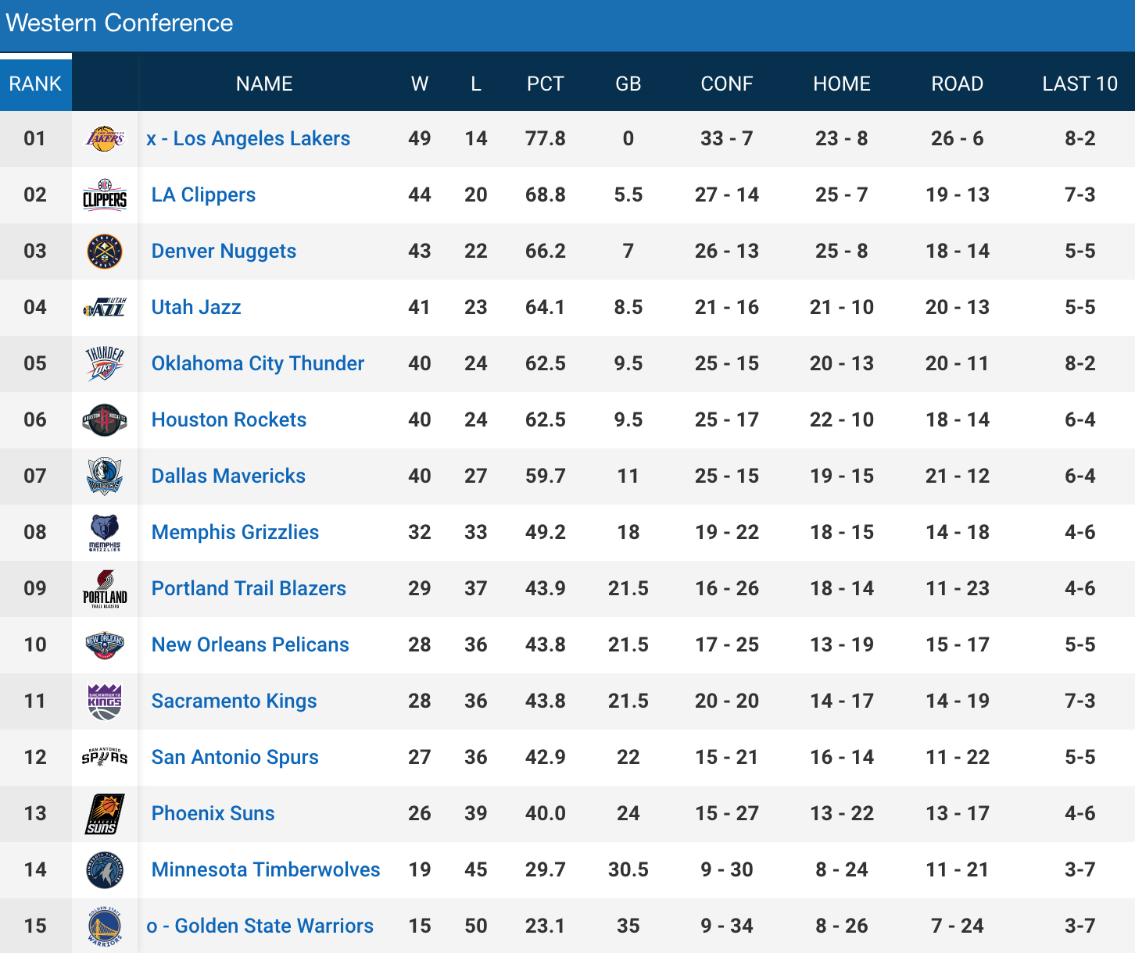

Slide 3

This Photo by Unknown Author is licensed under CC BY-NC-ND

Slide 4
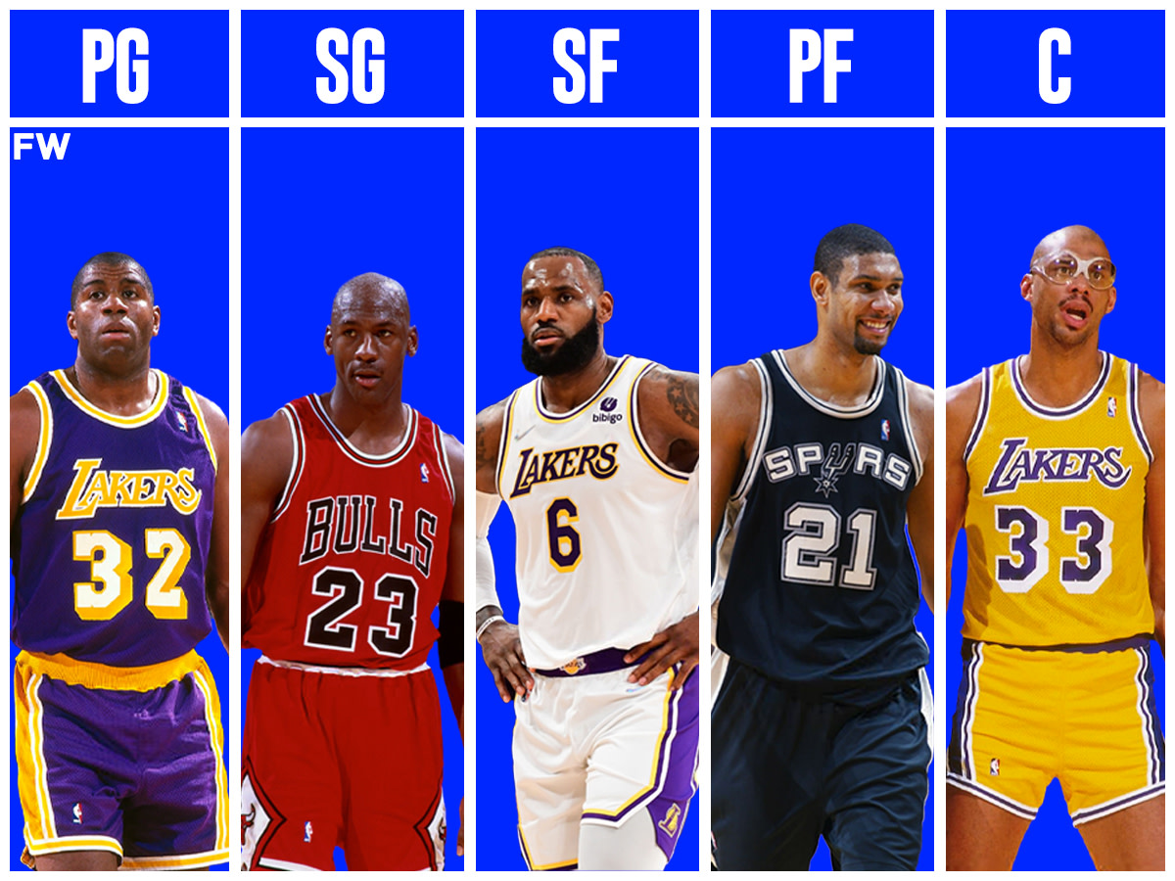

Slide 5
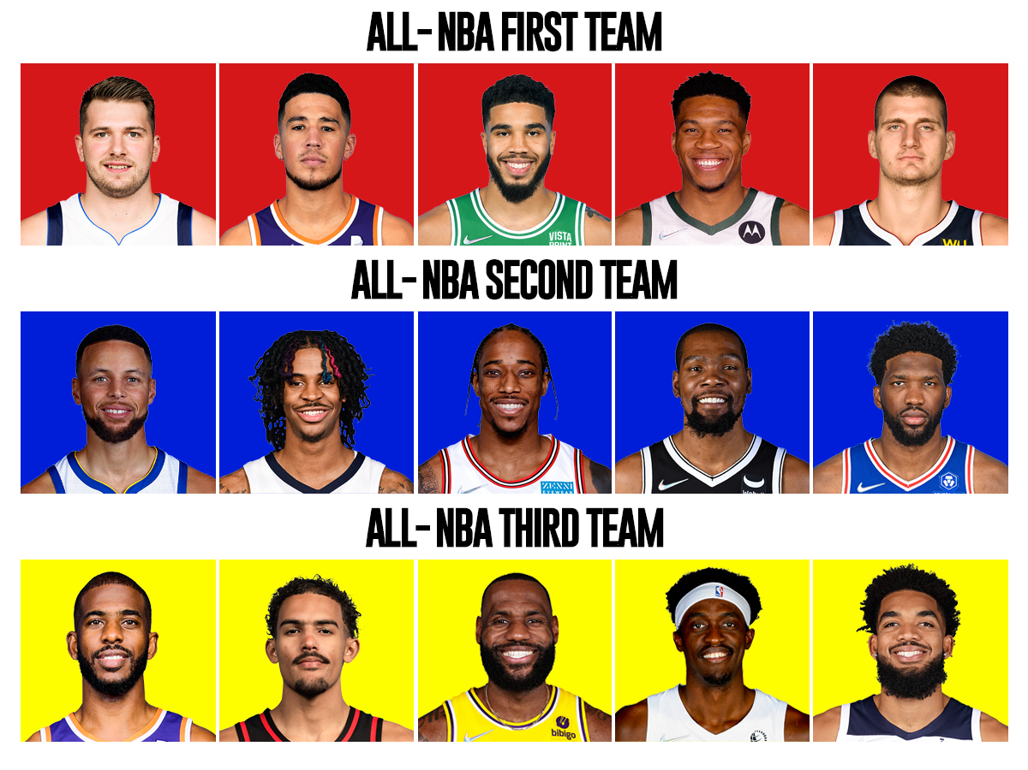
2021-22 season

Slide 6
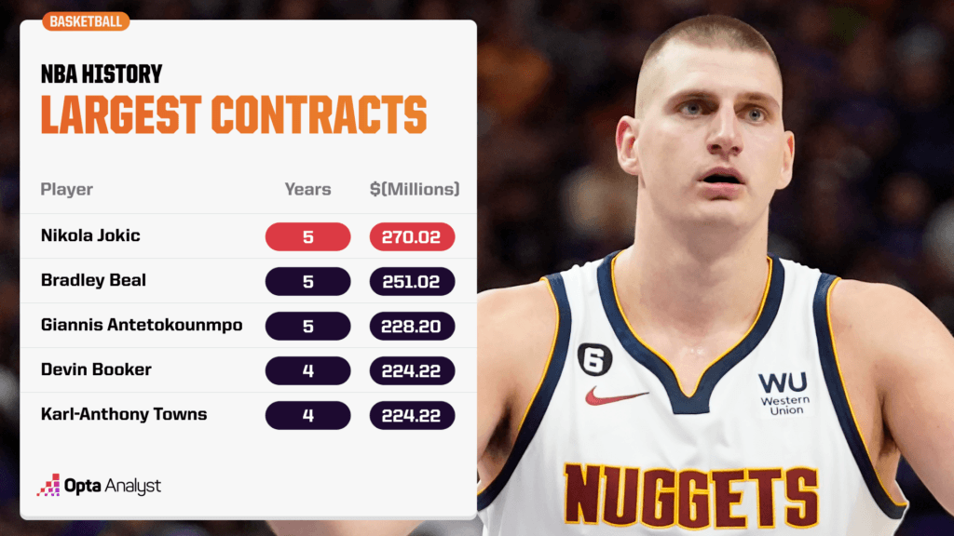

Slide 7
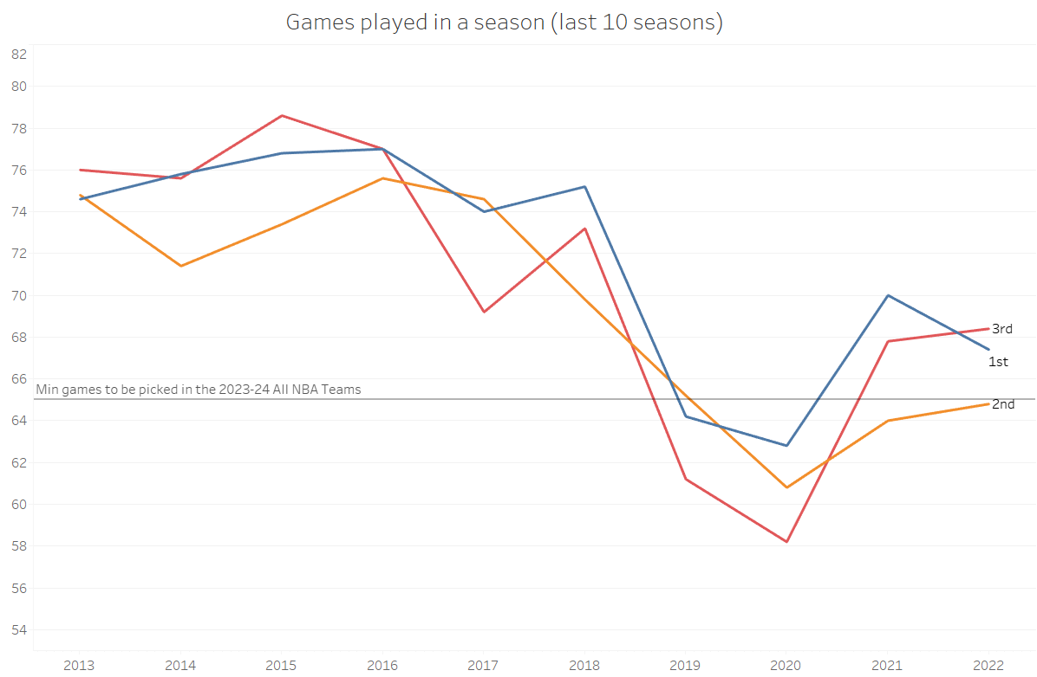

Slide 8
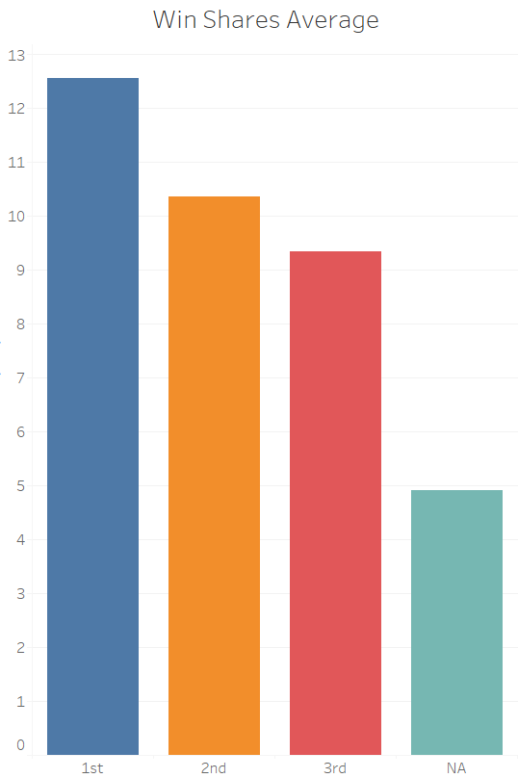

Slide 9
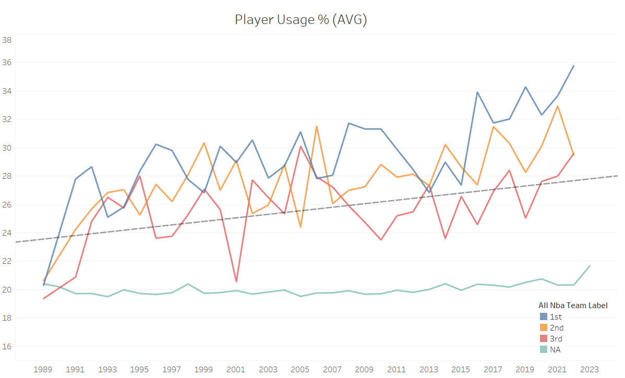

Slide 10
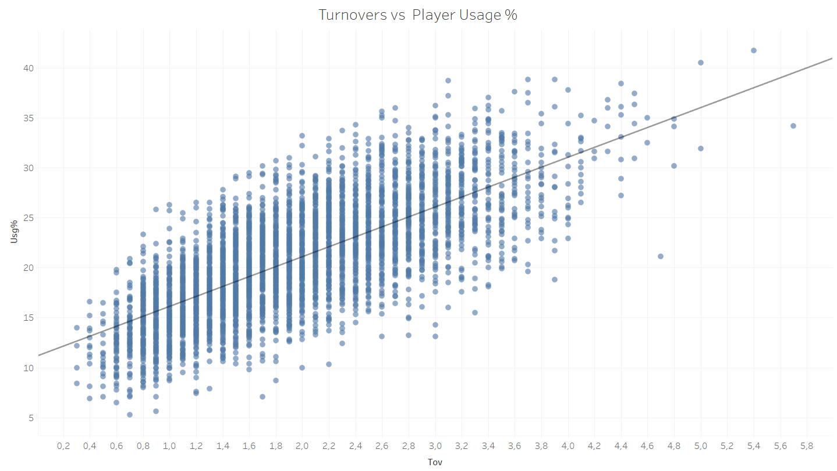

Slide 11
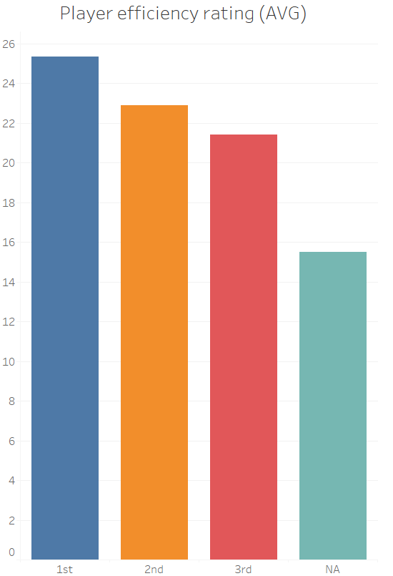

Slide 12
Conclusions
To be picked for the All NBA Teams a player has to:
Play more than 65 games
Overscore the rival team when he’s playing
Participate a lot during the game
Be super efficient

Slide 13
Thank you for your attention

